Slide 1
IR Image Registration Using Orientation

Slide 2
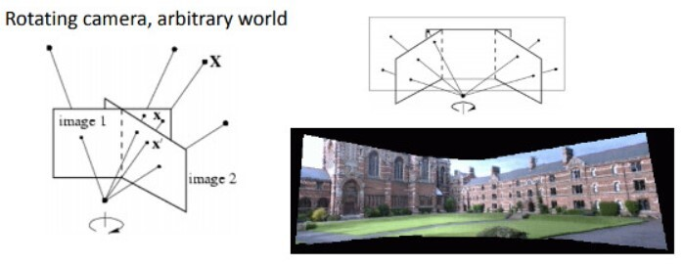
Purpose
This is one of the examples of the image stitching process. The camera is rotating but the coordinates of the camera are fixed,it just flips.

Slide 3
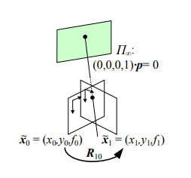

Mathematical Formula
K-intrinsic matrix
R10-Rotation matrix
H10-homography matrix
Pure 3D camera rotation. The form of the homography (mapping) is particularly simple and depends only on the 3D rotation matrix and focal lengths

Slide 4
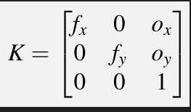
Intrinsic matrix
ox=W/2
oy=H/2
fx and fy can be found manually calculated using exif data or by comparing two images using autostitch.exe or darkcalibration application by detecting corners.
fx and fy – focal lengths
ox and oy –centre pixel of x and y axis respectively
K-intrinsic matrix

Slide 5
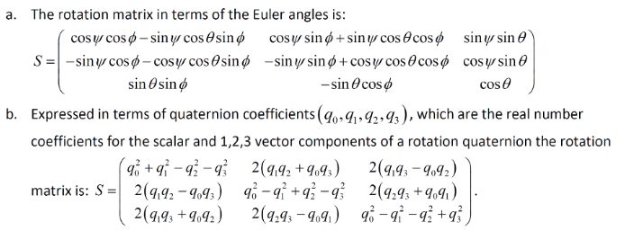
Rotation matrix (quaternions and angles)

Slide 6
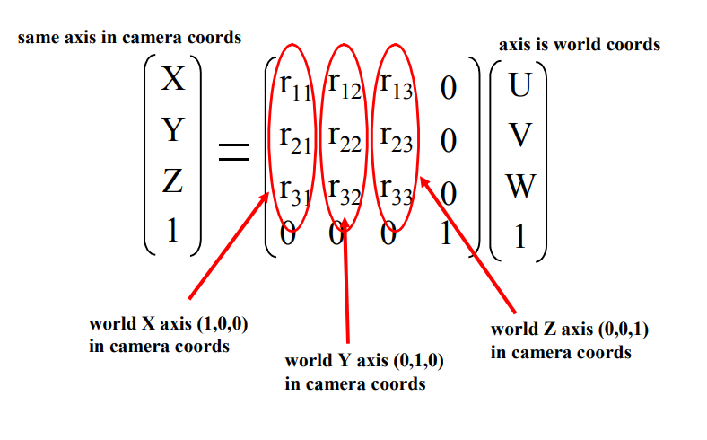
Rotation matrix
Rotation matrix can be found with quaternions and angles

Slide 7
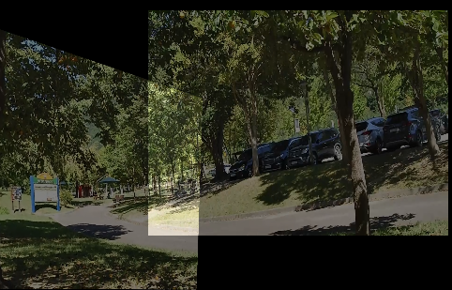
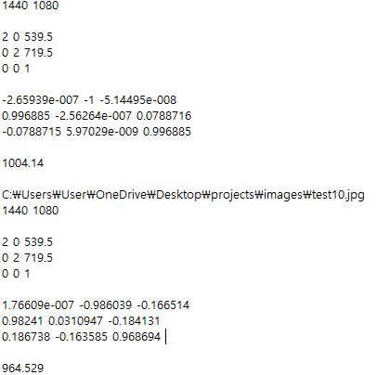
Examples
These two images alignment using pano.txt

Slide 8
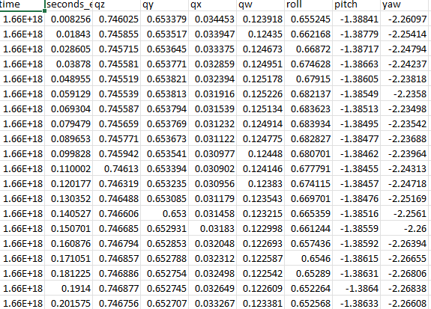
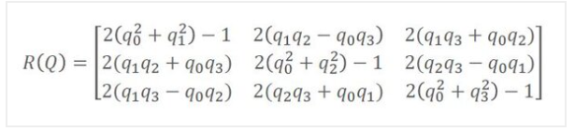

Plan
Doing image alignment using quaternion which is given by the dataset.And using given formula,calculate rotation matrix M.

